Slide 1



Transcribing Regional Bangladeshi Dialects:
A Dual-Stage Sequential Fine-Tuning Approach
Team Name : Backprop Sust
MD Nasiat Hasan Fahim,
Dept of CSE,
(Session: 2020-21),
SUST
Miftahul Alam Adib,
Dept of Statistics,
(Session: 2023-24),
SUST
Arif Hussain,
Dept of Mathematics,
(Session: 2022-23),
SUST

Slide 2

শব্দতরী: Where Dialects Flow into Bangla
Development of automatic speech recognition (ASR) models that transcribe regional Bangladeshi dialects into standard Bangla text. The competition features audio recordings from 20 regional dialects across Bangladesh, with the task of transcribing dialectal speech into formal Bangla text evaluated using Normalized Levenshtein Similarity.
Problem
Overview
Normalized Levenshtein Similarity to measure transcription accuracy

Slide 3
Knowing the domain
2. Previous works:
- DL Sprint - BUET CSE Fest 2022
- Bengali.AI Speech Recognition (most resourceful)
- ভাষা-বিচিত্রা: ASR for Regional Dialects (most relevant)
3. Selecting potential approaches
4. Understanding resource needs and our constrains
How we approached

Slide 4
Why it is very hard?
Acoustic Variability:
Standard "/p/" in Pani (water) Regional "f" in Fani.
Morphological Variation
Standard "Jabo" (I will go) : Regional "Zaiyum" or "Zamu"
Bengali language
Great Example of Similarity (Homophones)
কমলে কিট হয়েছে
তোমার ব্যাথা কমলে ওষুধ খেয়ে নিও।

Slide 5
01
শব্দতরী: Where Dialects Flow into Bangla
Features audio recordings spanning 20 regional dialects.
Contains 3,800 samples from both male and female speakers
02
DL Sprint (external dataset)
First Massively Crowdsourced (MaCro) Bengali dataset with 1,200 hours of data.
Datasets
Includes varied speech contributions from ~24,000 people across India and Bangladesh.
03
Bengali. AI Speech Recognition (external dataset)
Sourced from Common Voice, comprising approximately 400 hours of Bengali audio.
Massive collection structure containing 222,000 files

Slide 6
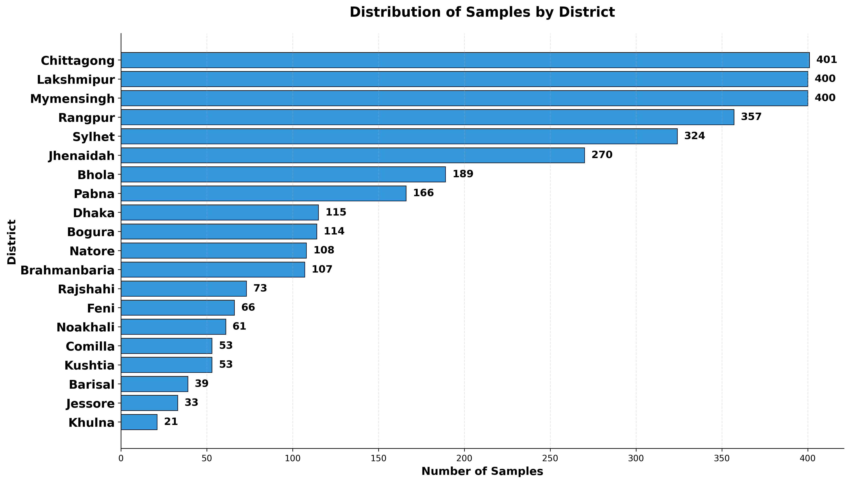
TEXT STATISTICS BY DISTRICT

Slide 7
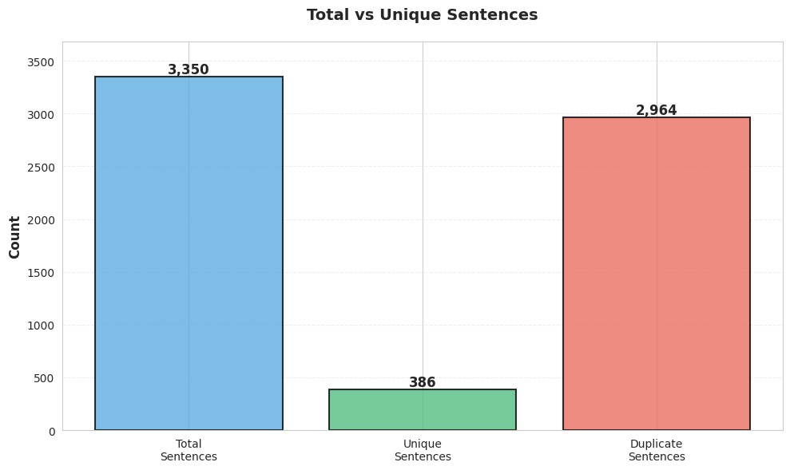
No numbers or English characters
                No special characters
                Sequence length are between 20 to 50.

Slide 8
02
Bengali.AI Speech Recognition
Focus: specifically curated to refine the model's handling of short, concise phrases.
Strict Filtering: Retained only sentences containing 4 to 5 words.
Data filtering
03
DL Sprint
Quality Filtering: Strictly selected samples with >3 upvotes and <1 downvote to ensure transcription accuracy.
Length Constraint: Filtered for sentence lengths between 4 and 11 words.

Slide 9
Dataset Name | Total Samples | Avg Char Length | Avg Bengali Chars | Avg Word Count | Avg Punctuation
Shobdotori | 3,350 | 29.66 | 24.25 | 5.39 | 1.01
DLSprint (CV) | 2,389 | 51.19 | 43.30 | 7.62 | 1.20
BengaliAI Speech | 3,719 | 30.71 | 25.90 | 4.65 | 1.12
Structural Statistics of Bengali Datasets (Corpus Characteristics)

Slide 10
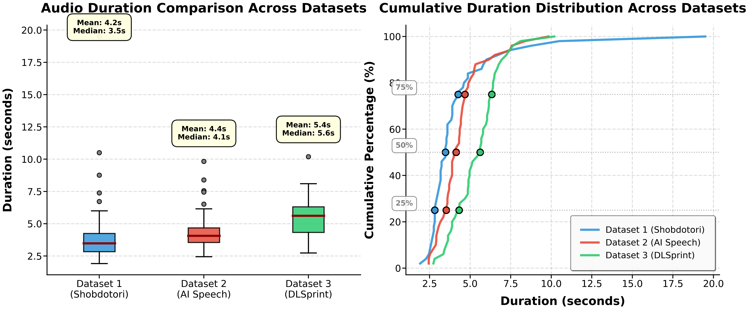
Audio duration Analysis

Slide 11

Methodology

Slide 12
Evaluated Architectures
OpenAI Whisper
Wav2Vec 2.0
- IndicWav2Vec
Models In Considerations
Selected Model: Whisper Medium
Why: Foundation of the Bengali.AI Speech Recognition 1st Place Solution and ভাষা-বিচিত্রা
Implementation Strategy
Initialized using the winner's pre-trained weights.
Adopted their specialized post-processing technique.

Slide 13
01
Audio Processing
Resampling: resampled to 16 kHz mono-channel (using librosa)
Feature Extraction: Raw waveforms were converted into Log-Mel Spectrograms
02
Text Normalization
Noise Removal: Filtered out non-speech artifacts (e.g., <>, ..) and distinct English characters ([a-z,A-Z])
Whitespace Handling: Stripped leading/trailing whitespace
03
Dataset Management
Dialect Balance: Stratified sampling preserves distribution across all 20 dialects.
04
Dynamic Construction
Data Preprocessing Pipeline
custom data collator for batch-level dynamic padding and masking (-100).

Slide 14
Comparative Experimental Results
Experiment | Model Architecture | Training Configuration | Public LB Score (NLS) | Private LB Score (NLS)
Baseline 1 | Whisper Small | Static Pad, No Metric | 0.76897 | 0.71913
Baseline 2 | Whisper Small | Static Pad, NLS Tracking | 0.78123 | 0.74525
Baseline 3 | Whisper Small | Dynamic Pad, NLS Tracking | 0.83557 | 0.80765
Interim 1 | Whisper Medium | Main Data + Static Pad + Post-processing | 0.91461 | 0.86970
Interim 2 | Whisper Medium | Main Data + Dynamic Pad + Post-processing | 0.91664 | 0.87203
Proposed | Whisper Medium | Dual-Stage Sequential FT + Post-processing | 0.91345 | 0.88077

Slide 15
**Everything has to be done keeping resource constraints in mind
**Fine-tuning can easily lead to catastrophic forgetting
Denoising
Data imbalance handling
Data Augmentations
Model parameters tuning
Lora parameter tuning
Transcribe Translate
Adding of external data:
  Tuning the model with external data
  Adding data to training
Start of innovation

Slide 16
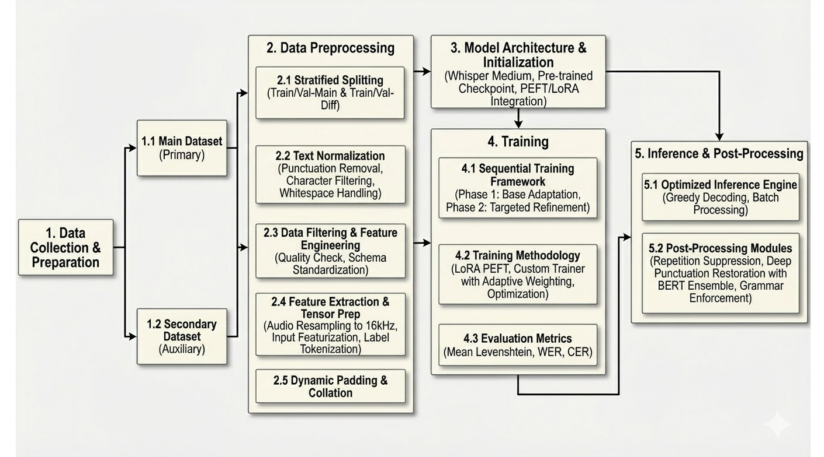




Slide 17
Configuration (Phase-1)
Source: Merged Main Dataset + DL Sprint Corpus.
Validation: Evaluated against val_main and val_diff (DL Sprint).
Initialization:Bengali ASR 1st Place Whisper-medium weights.
Composite Scoring:Sfinal​=(0.89×WERmain​)+(0.11×WERdiff​)
Hyperparameters: Epochs: 10, Warmup Steps: 100, lr = 1e-4
Phase 1 & Phase 2
Configuration (Phase-2)
Source: Merged Main Dataset + AI Speech Corpus.
Validation: Evaluated against val_main and val_diff (DL Sprint).
Initialization: Optimal checkpoint from Phase 1.
Composite Scoring:Sfinal​=(0.95×WERmain​)+(0.05×WERdiff​)
Hyperparameters: Epochs: 8, Warmup Steps: 0, lr = 1e-4

Slide 18
01
Optimized, Low-Latency Deployment
Greedy Decoding for Speed: Utilized num_beams=1 to bypass beam search,
Throughput Maximization: Employed a batch size of 4 on T4 GPUs, balanced with max_new_tokens=128
02
Robust Post-Acoustic Refinement
Artifact Suppression: Implemented a rule-based filter to eliminate model "stuttering" by suppressing word sequences that repeat more than 8 times.
Deep Punctuation Restoration: four-model BERT ensemble Bengali punctuation restoration (,।, ,, ?), using Class-Weighted Voting [1.0, 1.4, 1.0, 0.8].
Inference and Post-Processing Pipeline
What We Planned But Couldn't Try
Teacher-Student Model
Cloud-Scale Training:

Slide 19
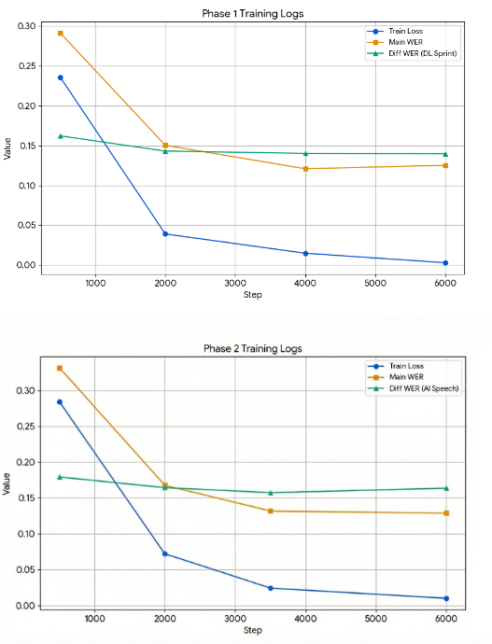
Linguistic Challenges
Phonetic Confusion: Distinct dialectal sounds (e.g., Sylheti tones) occasionally mapped incorrectly to standard Bengali phonemes.
Vocabulary Gaps: The model struggled with "long-tail" that were absent from the standard training
Post-Processing Artifacts:
Premature Termination: The BERT punctuation model sometimes inserted periods too early in complex, multi-clause sentences.
Incomplete Normalization: Certain deep colloquialisms remained unstandardized despite the Seq2Seq training.
Computational Constraints: Limited by Kaggle’s Tesla T4 (15GB VRAM), forcing a small batch size of 4
Error Analysis & Observations

Slide 20
Conclusion:
We developed an end-to-end pipeline successfully creating a robust system capable of handling phonetic variations across 20 distinct Bangladeshi dialects. Though constrained by GPU limitations, we ensured our methodologies were highly resource-efficient to maximize project outcomes. Our experiments confirmed that large-scale models can be effectively adapted with a small dataset (3,350 samples) to accurately transcribe and normalize non-standard dialect speech
.
Acknowledgment:
We thank the AI-FICATION organizing committee
and the Department of Electronics & Telecommunication Engineering, CUET, for organizing this
competition.

Slide 21

Thank You
Any Question?

